Slide 1
Orvepitant first in category, once daily, novel treatment for Idiopathic Pulmonary Fibrosis Chronic Cough
January 2021

Slide 2
Summary - orvepitant first in class/category, novel treatment for debilitating chronic cough associated with the terminal orphan condition idiopathic pulmonary fibrosis
Substance P/ Neurokinin-1 receptor is a highly validated cough target
Orvepitant has the ideal neurokinin-1 receptor antagonist profile
Orvepitant demonstrated clinically relevant and statistically significant improvements in cough burden in a Ph2b chronic cough study and has a good safety and tolerability profile
Orvepitant proven benefit to reduce chronic cough burden
Severe coughing “one of the most burdensome aspects” of this terminal orphan disease” (FDA)
IPF chronic cough is the same hypersensitivity mechanism as refractory/unexplained chronic cough (RUCC); and therefore orvepitant expected to be an effective treatment
Substance P is implicated in the pathology of IPF cough
IPF a terminal orphan condition and cough has a high unmet need
Team with proven track record to optimise an asset
The NeRRe management team recently sold KaNDy Therapeutics to Bayer in a deal valued >$1b
Collectively > 100 years Pharma experience
Experts in Chronic Cough development

Slide 3

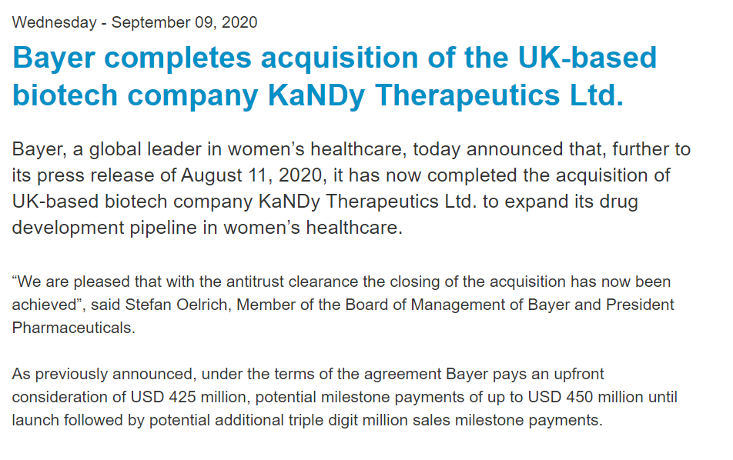
Proven management team & committed Board and Investor syndicate

Slide 4
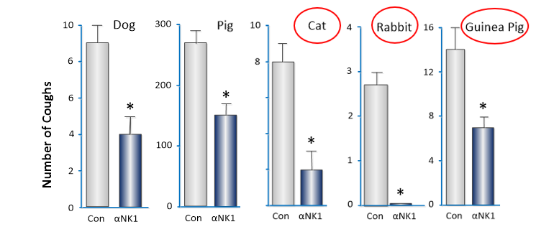
Substance P (SP) is an important cough mediator and NK₁R a key therapeutic target
NK1 antagonist centrally
administered into brainstem
Modified from Canning (2009)
Cough reflex is sensitised by various chemical/ mechanical stimuli including by direct SP injection into the brainstem^{1,2,3}
Blocking brainstem NK1Rs attenuates this sensitisation^{1,4,5}
Hence targeting the brainstem ‘Cough Centre’ with a centrally active NK₁R antagonist would be expected to reduce cough hypersensitivity
Reduction in evoked cough in five different animal species

Slide 5
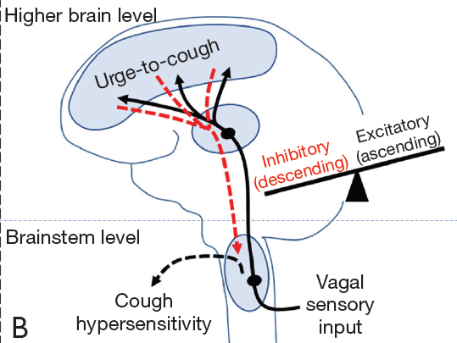
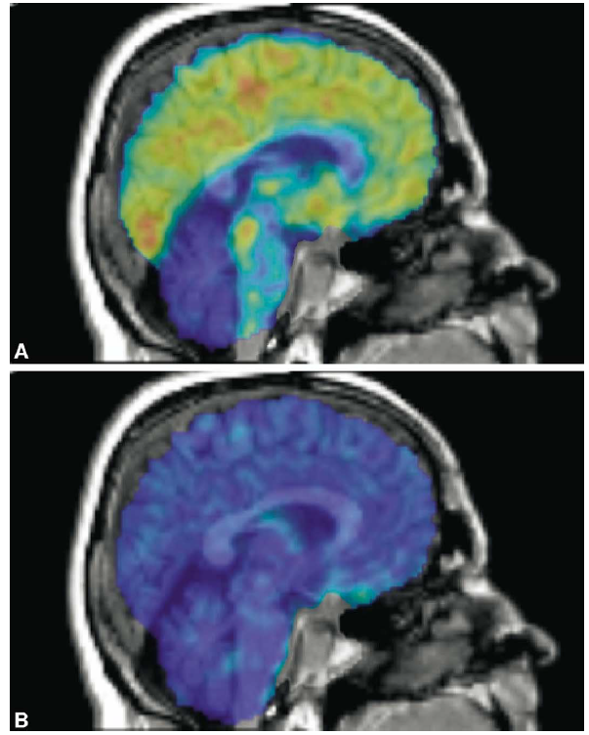
NK₁Rs are expressed in the brain regions associated with the sensation of ‘Urge to Cough’
PET scans of brain NK₁ receptors, overlaid on MRIs before (top) and after (bottom) blockade with NK1R antagonist aprepitant¹
Blue indicates low tracer binding, yellow and orange indicate high tracer binding
Mazzone & McGarvey (2020)
Primary airway afferents synapse in the brainstem ‘Cough Centre’ can stimulate second-order neurons projecting to higher brain regions to evoke the sensation of an ‘Urge to Cough’ ²
Human PET studies show expression of NK₁Rs in the brain regions associated with the ‘Urge to Cough’ sensation³

Slide 6
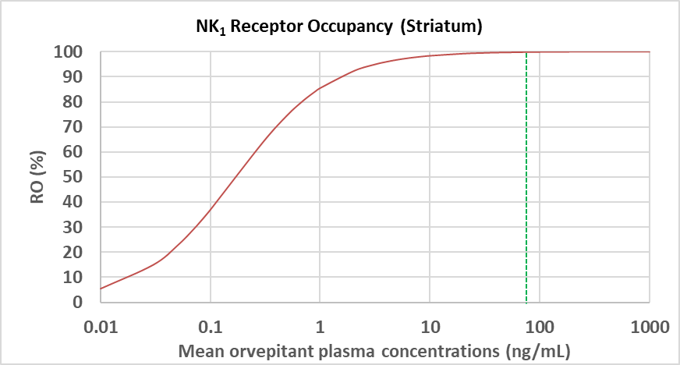
Orvepitant has the ideal profile for treating chronic cough as a small tablet once daily
Orvepitant is a potent and selective antagonist of the human NK₁ receptor
Human PET study shows orvepitant is brain penetrant
30 mg once daily achieves full CNS NK₁ receptor occupancy throughout the 24 hour dose interval
Control
1 nM orvepitant
3 nM orvepitant
10 nM orvepitant
Human brain NK1 RO v. plasma exposure
30 mg
Full receptor occupancy for 24 hours is likely to be required for efficacy in cough hypersensitivity
Notes:
¹Ando A et al. Neural correlates of cough hypersensitivity in humans: evidence for central sensitisation and dysfunctional inhibitory control. Thorax. 2016 Apr;71(4):323-9.
²Keller M et al. Lack of efficacy of the substance p (neurokinin1 receptor) antagonist aprepitant in the treatment of major depressive disorder. Biol Psychiatry. 2006 Feb 1;59(3):216-23.
³Ratti E, Trower M et al. Full central neurokinin-1 receptor blockade is required for efficacy in depression: evidence from orvepitant clinical studies. J Psychopharmacol. 2013 May;27(5):424-34.
⁴Rupniak NMJ, Kramer MS. NK1 receptor antagonists for depression: Why a validated concept was abandoned. J Affect Disord. 2017 Dec 1;223:121-125.

Slide 7
Phase 2b data - 30 mg orvepitant is significantly better than placebo on three patient reported measures of cough burden in refractory and unexplained chronic cough (RUCC)
Urge to Cough VAS
Leicester Cough Questionnaire
Cough Severity VAS
Week | 2 | 4 | 8 | 12
P-value | 0.056 | 0.031 | 0.047 | 0.005
Week | 2 | 4 | 8 | 12
P-value | 0.003 | 0.029 | 0.025 | 0.009
Week | 2 | 4 | 8 | 12
P-value | 0.055 | 0.043 | 0.022 | 0.034
VOLCANO-2: PRO findings demonstrate broad effects on cough hypersensitivity symptoms

Slide 8
Phase 2b data - 30 mg orvepitant is significantly better than placebo on cough frequency in RUCC patients in a pre-defined group with higher frequency cough
VOLCANO-2: Cough Frequency Findings
p=0.009
p=0.066
Significantly higher response rate in the higher frequency coughers

Slide 9
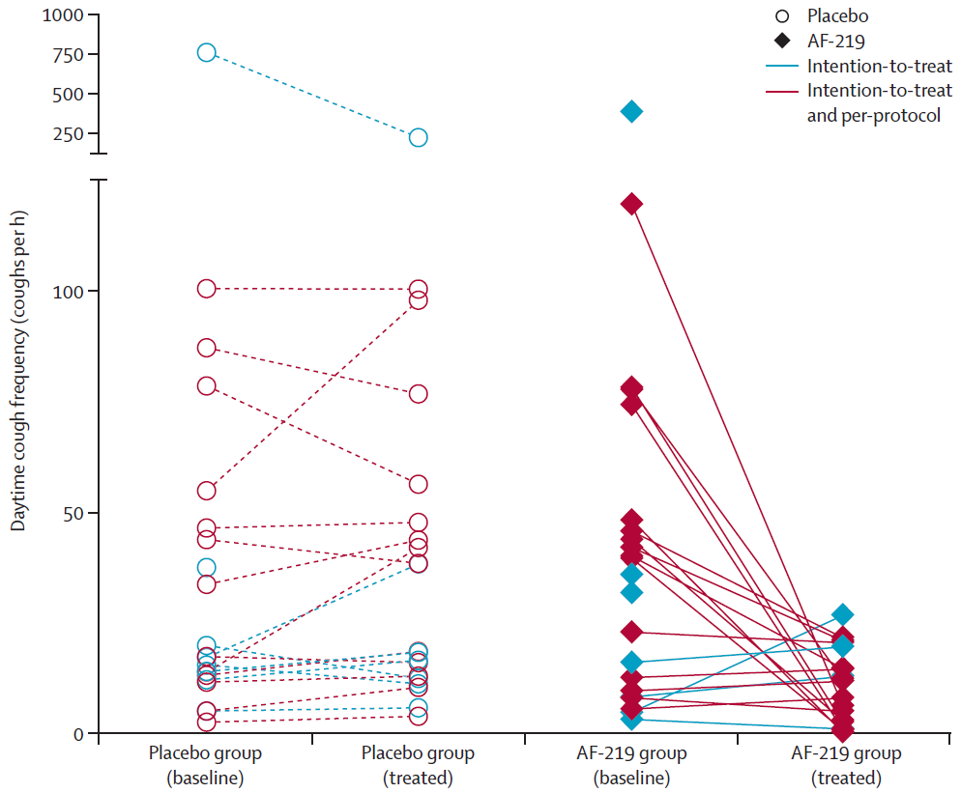
3rd party review and support for the orvepitant Ph2b data
Inability to detect a response seen before
Review by cough experts
Review by the FDA
The FDA:
support further development including to Phase 3
Is willing to consider a patient reported outcome (PRO) as the primary efficacy endpoint, subject to qualification
"the subjective data is compelling evidence that we have an effective drug - good case to go to the FDA with alternative end points
“orvepitant is the second viable candidate for a novel cough controller"
Future development of orvepitant has been de-risked

Slide 10
With a proof of concept in 1 chronic cough the door is open to other chronic cough indications
KOL feedback - due to the central MoA orvepitant could have value as a treatment for all chronic cough types
RUCC
High unmet need
Clear rationale
Niche Pharma interest
Population not easy to define in non-expert centres
COPD cough
High unmet need
Clear rationale
Attractive to Pharma
Concern about supressing productive cough
Asthma cough
High unmet need
Clear rationale
Attractive to Pharma
More accessible population
IPF cough
Highest unmet need – patients are terminal
Clear rationale
Very attractive to Pharma and Biotech
Orphan condition
IPF highest unmet need and a logical route to market

Slide 11
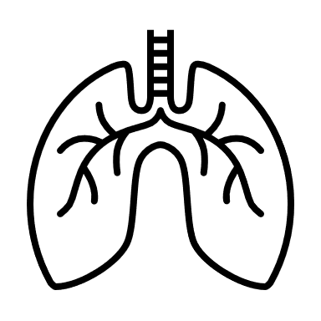
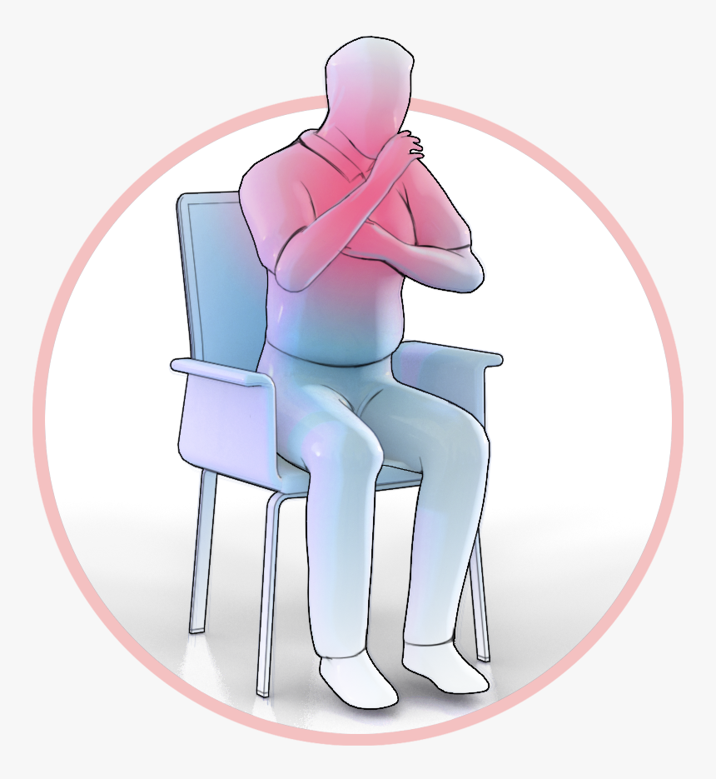
Idiopathic Pulmonary Fibrosis is a chronic life-limiting orphan disease in which cough is a cardinal symptom
FDA “voice of the IPF patient”
IPF is a progressive, fatal, orphan lung disease
Of unknown cause
Median survival of 3-5 years after diagnosis
A persistent dry cough and dyspnoea are the cardinal symptoms
Cough occurs in >80% of patients
IPF cough is disabling and
often precedes dyspnoea by several years
is an independent predictor of disease progression
may contribute to disease progression
is often unresponsive to anti-tussive therapy
“On my worst days, coughing will wipe you out for an entire day … Physically, you're exhausted.”
“My cough was really so deep that it felt like I broke my ribs, and my ribs became so cramped that I couldn't even twist [my body].”
“One caregiver shared that his wife would “just be soaking wet [from sweat]” after a coughing fit

Slide 12
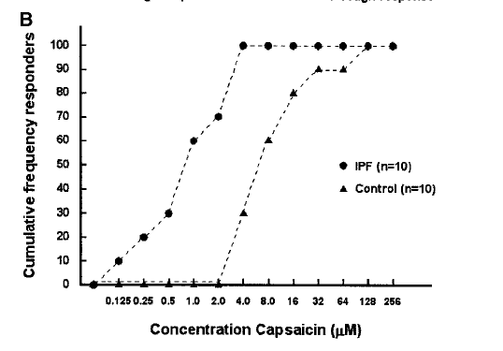
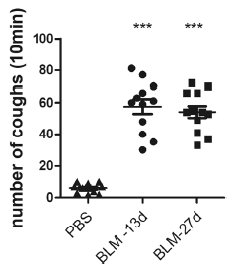
Patients with IPF have the same cough hypersensitivity syndrome as patients with refractory and unexplained chronic cough
 | RUCC | IPF
Dry, non productive cough | ✓ | ✓
Cough in response to innocuous stimuli | ✓ | ✓
Feeling of the urge to cough | ✓ | ✓
Increased cough response to inhaled capsaicin | ✓ | ✓
Enhanced cough reflex response to chest wall mechanical stimulation | N/A | ✓
Hope-Gill et al., 2003
***p < 0.001 vs control
Significantly increased cough response to capsaicin in the guinea-pig ‘gold standard’ bleomycin lung fibrosis model
Guo et al., 2019

Slide 13
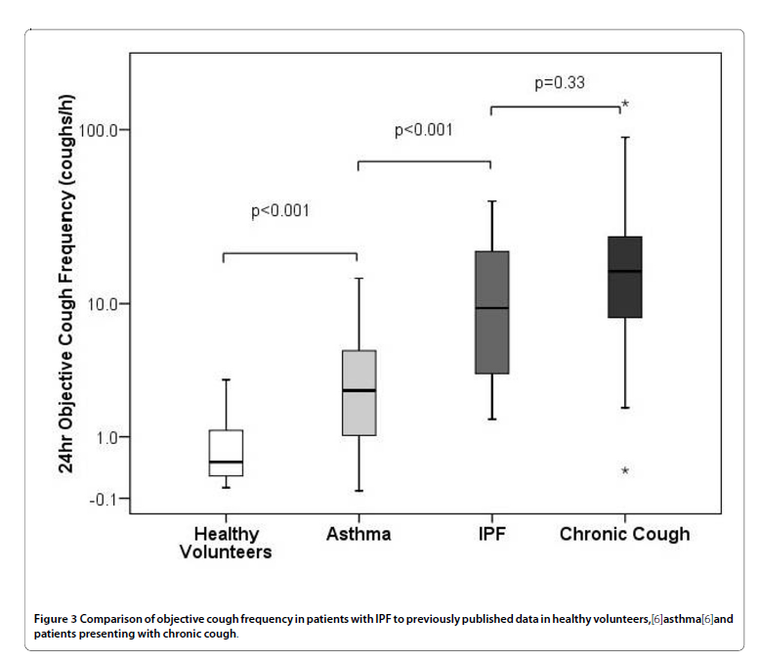
The cough burden in IPF is high and comparable to that in refractory and unexplained chronic cough
Cough frequency in IPF is high
Disease | Study | Cough Severity VAS (mm) | Urge to Cough VAS (mm) | Cough Frequency (coughs/hour)
RUCC | Orvepitant (V-2) | 68 | 70 | 43
 | Gefapixant (Phase 2b)¹ | 58 | NR | 24 to 29
 | BLU-5937 (Phase 2a)² | 73 | NR | 26-32
IPF Cough | RVT-1601 (Phase 2a)³ | 62 | NR | 51 to 55
 | Thalidomide⁴ | 65 | 68 | 28
 | Pirfenidone⁵ | 67 | 67 | NR
Smith et al, Lancet Resp Med 2020;8:775-785; Bellus Health, Phase 2 Topline Data Presentation July 6, 2020 ; Birring et al, Lancet Resp Med 2017;5:806-815; Horton et al, Ann Int Med 2012;157:398-406; Van Manen et al, ERJ 2017;50:1701157

Slide 14
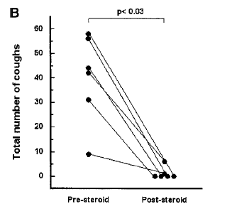
Evidence that Substance P / NK₁Rs also play a key role in lung pathophysiology in IPF cough
IPF patient lungs have raised levels of polymorphonuclear cells and mast cells producing sensory nerve activating inflammatory mediators such as SP^{1,2}
SP levels in BAL fluid are increased in IPF compared to healthy controls (p<0.01)³
A cough response was triggered by inhaled SP in 7/10 IPF cough patients, but not healthy controls (p<0.002); effect blocked by steroid therapy (p<0.03) ⁴
Hope-Gill et al., 2003
Fig 3. Steroid therapy (for 4-weeks) caused abrogation of the direct cough response to inhaled SP (B; p 0.03).( B) represents a cumulative cough score produced in response to five sequential inhalations of 1.0 M SP solution

Slide 15
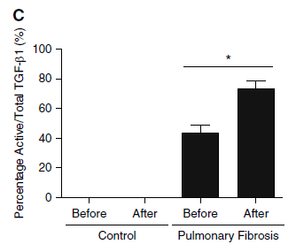
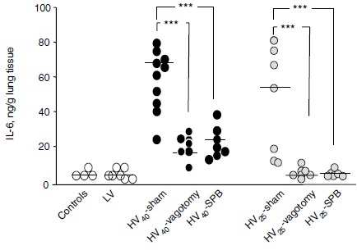
Reducing cough in IPF thereby decreasing the repeated mechanical injury to the lung could slow disease progression?
Mechanical stretch is known to be associated with activation of key fibrotic mediators¹
Fibrotic lung strips from rats and IPF patients responded to tensile force by releasing TGF-β1³; and activating mast cells⁴
In a rat study, high airway pressure increased lung SP levels, and the proinflammatory and profibrotic mediators IL-1β and IL-6; these effects were markedly reduced by bivagotomy and NK₁R blockade⁵
TGF-1β activation in human non-fibrotic control lung tissue biopsies versus IPF lung tissue before and after application of the mechanical force *p<0.05
Froese et al., 2016
Brégeon et al., 2010
Key:
HV40 or 25 are cmH2O high airway pressure
SPB – SP blockade by NK₁ antagonist

Slide 16




Series C objective is to confirm that orvepitant is an effective treatment for debilitating chronic cough associated with the orphan condition idiopathic pulmonary fibrosis.
Proceeds will fund a phase 3 ready package of pre-clinical and clinical studies designed to show efficacy in IPF cough and disease modification potential.
Key deliverables:
  A phase 2 study in IPF cough
  A pre-clinical package that demonstrates upside disease modification potential
  Orphan drug designation
  FDA End of Phase 2 meeting
  Phase 3 enabling work

Slide 17
Orvepitant first in category, once daily, novel treatment for Idiopathic Pulmonary Fibrosis Chronic Cough
January 2021

